Slide 1


Project plan of TEAMTEAM
Jorge Blanco Rey
Ángel Casanova Bienzobas
Rodrigo Juez Hernández
Pablo Soëtard García
Group: 2391, team 2
Notes:
Hi, we are Ángel Casanova, Rodrigo Juez, Pablo Soëtard and Jorge Blanco.

Slide 2
Content
Introduction
Project Definition
Project Estimation
Project Planning
Project Monitoring and Control Procedure
General reflection aspects
Specific reflection aspects
Conclusions

Slide 3
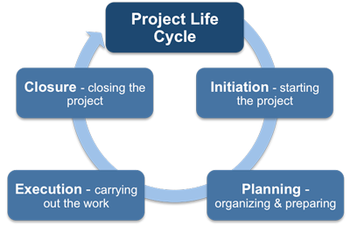
1. Introduction
Project Definition
Project Estimation
Project Planning
Project Monitoring and Control Procedure
Notes:
We are going to talk about the project definition, then an estimation of the resources, the planning and finally how are we going to monitor everything we do, it is a lot, so let is get right into it!

Slide 4
Content
Introduction
Project Definition
Project Estimation
Project Planning
Project Monitoring and Control Procedure
General reflection aspects
Specific reflection aspects
Conclusions

Slide 5







2. Project Definition
Team Management Subsystem
Meeting Scheduling Subsystem
Meeting Management
Subsystem
Meeting-making
Subsystem
Statistics Management
Subsystem
Notes:
After going through analysis and design phases we obtained 5 subsystems where we covered all the requirements, these are:
1.- Team Management
The requirements fulfilled are related to creation of teams, adding a student to the team, handling preferences between others.
2.- Meeting Scheduling
The Meeting Scheduling Subsystem allows students to see pending or completed teamwork meetings.
3.- Meeting Management
The Meeting Management Subsystem will handle the requirements regarding creating meetings, having a meeting date agreement mechanism and managing the rooms that make up the meeting infrastructure.
4.- Meeting-making
The Meeting-making subsystem will manage the automatic delivery of practical assignments to Moodle, provides an in-call toolbox for students, that will include the all the necessary tools that the student may need during the call.
5.- Statistics Management Subsystem
The Statistics Management Subsystem will cover professors textual and graphical reports. These reports must contain enough information for teachers to evaluate the scope and complexity of the practical assignments.

Slide 6
Content
Introduction
Project Definition
Project Estimation
Project Planning
Project Monitoring and Control Procedure
General reflection aspects
Specific reflection aspects
Conclusions

Slide 7
3. Project Estimation
Complexity Factors | TDI
Data Communications | 3
Distributed Data Processing | 4
Performance | 3
Heavily Used Configuration | 2
Transaction Rate | 2
On-line Data Entry | 5
End-User Efficiency | 2
On-line Update | 4
Complex Processing | 1
Reusability | 0
Installation Ease | 0
Operational Ease | 2
Multiple Sites | 3
Facilitate Change | 4
TOTAL | 35
Subsystem | Unadjusted Function Points (UFP) | Adjusted Function Points (AFP)
Team Management | 83 | 83
Meeting Scheduling | 48 | 48
Meetings Management | 64 | 64
Meetings Making | 68 | 68
Statistics Management | 26 | 26
Total | 289 | 289
Notes:
The project estimation has been calculated using an empirical technique based on Function Points and adjusted with its complexity factor.
In the system data is transferred online in both directions between the server and the client, it has a high Distributed Data Processing complexity. As it is an interactive web portal, we will need an admissible time response and the system will have most of its inputs from online user interactions, hence it has some Performance complexity and a lot of On-line Data Entries.
On the other hand, as we have an adjustment factor of 1, we get the same amount of UFP than AFP, resulting in a total of 289 AFP.

Slide 8
3. Project Estimation
Subsystem | Adjusted Function Points (AFP) | Effort in Person/Month | Duration in Days | Lines of Code OOP | Documentation Pages
Team Management | 83 | 5,53 | 117,333 | 2407 | 41,5
Meeting Scheduling | 48 | 3,2 | 67,467 | 1392 | 24
Meetings Management | 64 | 4,26 | 96,8 | 1856 | 32
Meetings Making | 68 | 4,53 | 98,267 | 1972 | 34
Statistics Management | 26 | 1,73 | 38,133 | 754 | 13
Total | 289 | 19,26 | 418 | 8381 | 144,5
Notes:
In this table we can see different estimations for the project based on its adjusted function points, we would need an average of 20 people per month working on our project and it would take around 418 days. We have chosen to develop the system on an OO Language, and based on the metrics from an internal survey of our company it takes around 29 LOC and 0.5 pages of documentation per AFP, resulting in more than 8K LOC and 145 documentation pages.

Slide 9
Content
Introduction
Project Definition
Project Estimation
Project Planning
Project Monitoring and Control Procedure
General reflection aspects
Specific reflection aspects
Conclusions

Slide 10
4. Project Planning
Increment | Subsystems per Increment | Adjusted Function Points | Effort (Person/Month) | Time (days)
1 | Team Management | 131 | 8.73 | 155
 | Meeting Scheduling
2 | Meeting Management | 132 | 8.79 | 131
 | Meeting Making
3 | Statistic Management | 26 | 1.73 | 42
Activity Performed | Effort
Requirements Analysis | 20%
Design | 20%
Coding | 15%
Unit Tests | 15%
Integration Testing | 20%
Installation | 10%
Notes:
We have divided the whole project in three increments, and we have calculated, using Microsoft Project, 155 131 and 42 days (about 1 and a half months), respectively. We managed to reduce the initial days estimated thanks to doing two subsystems at the same time per increment.
In total we need 328 days for finishing.

Slide 11
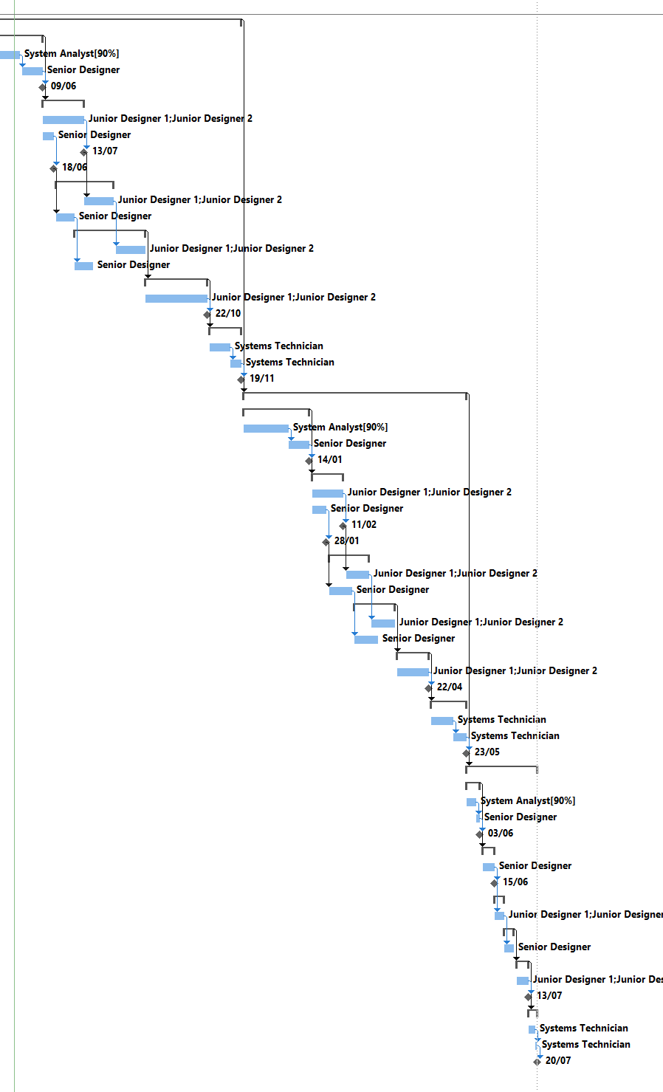
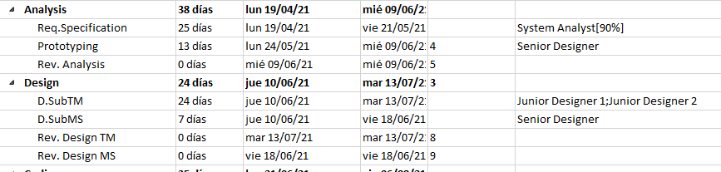
4. Project Planning
Activity Performed | Personal Assignation
Project Management Tasks | System Analyst
Requirements Analysis | System Analyst, Senior Designer
Design | Junior Designers, Senior Designer
Coding | Junior Designers, Senior Designers
Unit Tests | Junior Designers, Senior Designers
Integration Testing | Junior Designers
Installation | System Technician
Example of organization of juniors vs senior:
Notes:
Here we can see which kinds of worker handle which tasks.
Regarding the staff organization we have both junior designers in one subsystem, while the senior designer has a whole subsystem as it works faster.
The senior designer will work side by side with the juniors, this way he can help them and try to avoid issues as much as possible.

Slide 12
Increment 1 Increment 2

Slide 13
Increment 3

Slide 14
4. Project Planning
Employee | Cost | Working hours | Total (€)
System analyst | 400 €/day | 676.36h | 33,818
Senior designer | 350 €/day | 896h | 39,200
Junior designer 1 | 200 €/day | 1,448h | 36,200
Junior designer 2 | 200 €/day | 1,448h | 36,200
Technician | 300 €/day | 368h | 13,800
 | TOTAL | 4836.36 h | 159,218
Material | Cost | Amount | Total
Equipment | 1,050 €/ month | 2624 h | 17,220 €
Development Workstation | 1,650 € | 3 | 4,950 €
Performance Workstation | 3,200 € | 1 | 3,200 €
Integrated Development Environment | 1,100 € | 3 | 3,300 €
 |  | TOTAL | 28,670 €
Notes:
Here we can see the salary distribution and total working hours of each worker.
The working schedule will be Monday to Friday working 40 hours per week.
We are going to need some acquisitions of workstations and software, and fees will be charged for other equipment.

Slide 15
4. Project Planning
Increment | Cost
Increment 1 | 69.280,03 €
Increment 2 | 62.570,00 €
Increment 3 | 15.210,00 €
Project Management (Equipment, and 10% of System Analyst) | 41.927,98 €
Total | 188.988 €
Notes:
About the cost’s distribution per increment, we can clearly see that it is highly related with its duration.
That is why increments 1 and 2 share most of the budget while increment 3 is the shortest one, since it is the last one is where we are going to have less people working.
The 1st bar is all the common costs to all the increments.

Slide 16
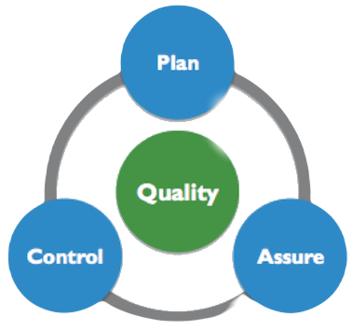

4. Project Planning
Quality Management Plan
Risk Management Plan
Notes:
We also followed the quality management plan in which we specified the analytical measurements, like revisions at the end of each phase, dynamic measurements, like the testing phase and then some organizational and humane constructive measurements to avoid risks.
We also defined risk management plans where identified the potential risks and thanks to revisions and meetings will be able to quickly course correct. These risks are the usual such as personal rotation, delaying more than expected, technical difficulties, as we have already explained in previous sections.

Slide 17
Content
Introduction
Project Definition
Project Estimation
Project Planning
Project Monitoring and Control Procedure
General reflection aspects
Specific reflection aspects
Conclusions

Slide 18

5. Project Monitoring and Control Procedure
Configuration project items:
Software requirements
System requirements
Database information
Design documentation
Notes:
The main goal of the progress monitorization is to provide an objective view of the project progress in terms of requirements and schedule, in respect to the initial estimations. To do so, we are going to stablish meetings with the development team, and with the client each time we achieve a milestone and at the end of each increment, this is to be able to pass to the next phase.
We will develop a software configuration plan at the begging of the analysis phase, and once an element becomes baseline, the project manager must approve or reject any modification that is proposed for that element.

Slide 19
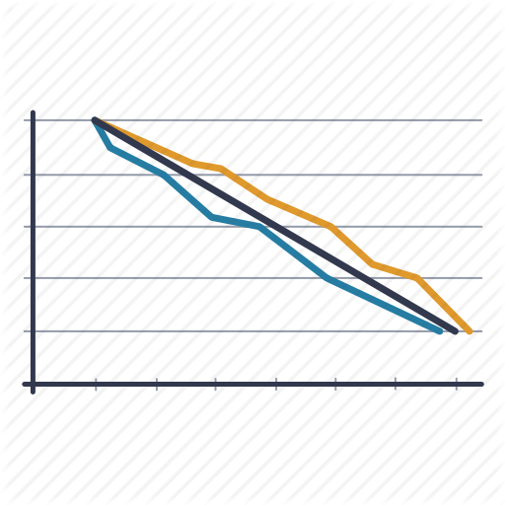

5. Project Monitoring and Control Procedure
The monitorization will be based in:
The datelines stablished in the Gantt diagram
Burndown schemas updates
Ensure that all the requirements are fulfilled
Clients are up to date
Milestones | Analyst | Senior Designer | Results
Rev. Analysis | X |  | Analysis document
Rev. Design. |  | X | Design document
Rev. Integration | X |  | Code Technical manual Installation manual
Rev. Installation | X |  | Final product User manual
Notes:
We have four milestones in the project, almost at the end of each phase, when we are going to do a revision of the work performed. We can also see who is the responsible of each revision (the analyst for analysis, integration and installation, and the senior designer for design), as well as the documents obtained at the end of each milestone.
The tools used are Gantt diagram, burndown schemas and meetings with the client to revise the progress.
After each increment we will have a delivery to you, the client, with all the documents and code generated until that point.

Slide 20
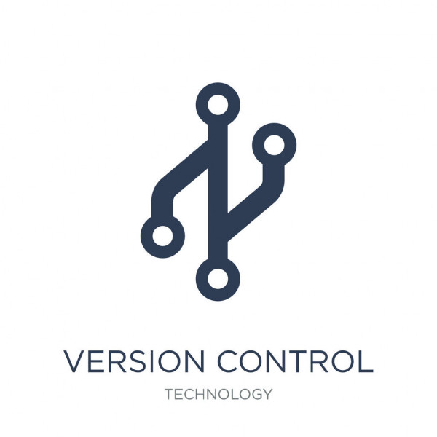

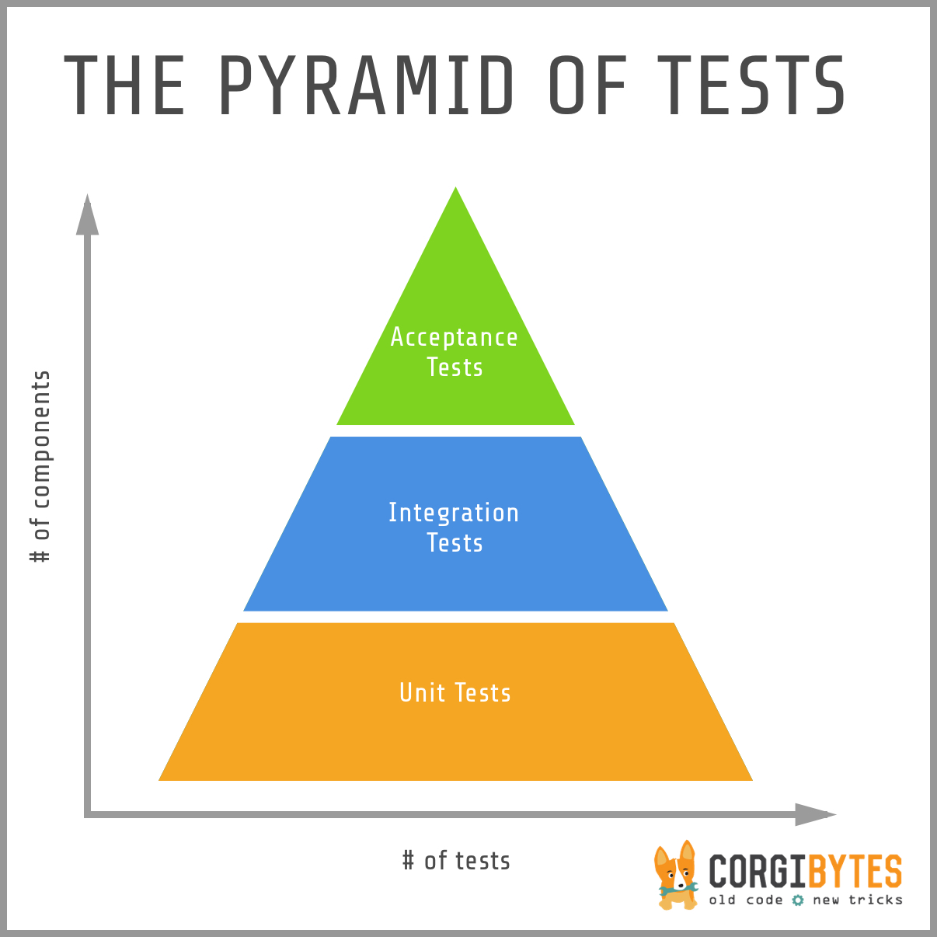
5. Project Monitoring and Control Procedure
Version Control
Verification Control Document
Testing
Notes:
For guaranteeing that all the requirements are fulfilled, we have developed a testing plan. This plan contains dynamic tests such as black box for all the modules and white box for two.
As we have a limited estimate, we cannot afford to do white box testing in every module. So, we have decided to carry out white box testing only on the modules related with the Meeting Scheduling and Statistics Management subsystems, since they are more connected and are smaller.

Slide 21
Content
Introduction
Project Definition
Project Estimation
Project Planning
Project Monitoring and Control Procedure
General reflection aspects
Specific reflection aspects
Conclusions

Slide 22

6. General reflection aspects
Difficulties encountered
Improvable aspects
Acquired knowledge
Cohesion and teamwork
Notes:
Difficulties encountered
It was difficult to find a good working schedule as well as good tools for doing and sharing the work between us, but as we were progressing, we learnt the best way to solve this problem, using Google Docs and Microsoft Office at the same time.
Improvable aspects
Some things we should improve, is to pay more attention when reviewing the documents before uploading, since we have had some errors that could have been easily corrected.
Acquired knowledge
We have learnt how to write technical formal documentation such as a viability plan, project estimations like workdays using Gantt Diagrams, using function points, and a risk plans as well as using the correct tools for it. And of course, we learnt how to be better at teamwork.
Cohesion and teamwork
We have tried to use the same templates that we were given along with the assignment, if possible.
To perform an efficient team workflow we have tried that all the members of the team where available on all the working session to ensure communication and effective collaborative work.

Slide 23
Content
Introduction
Project Definition
Project Estimation
Project Planning
Project Monitoring and Control Procedure
General reflection aspects
Specific reflection aspects
Conclusions

Slide 24



7. Specific reflection aspects
Quality of the planned project
Work procedure carried out to develop the Project Plan
Team Management
Individual or personal contribution in each of these three aspects of:
Jorge Pablo Rodrigo Ángel
Notes:
In order to guarantee the quality of the project, we downloaded the online versions of the documents to fix many bugs, Jorge mainly did that part.
Regarding our work procedure, we held meetings to determine how to face it. In those meetings we divided the work. And then revised each other’s.
Regarding the team management, each of us performed a role, Elena was the customer representative, Jorge the Project Documentation Manager and the Project quality manager and Rodrigo and I (Angel) were the project leader and head respectively.
Individual or personal contribution.
Jorge: I tried to revise grammar and coherence errors, by reading my own work and the one of my colleagues, as well as to give, maintain and correct the format.
Pablo: I tried to coordinate the team to parallelize and optimize the work schedules as much as possible.
Rodrigo: I tried keeping everything organized and knowing what part went where, trying to maintain a quality in the project.
Ángel: I have tried to properly explain everything that I have done to make it easy for my partners to understand it.

Slide 25
Content
Introduction
Project Definition
Project Estimation
Project Planning
Project Monitoring and Control Procedure
General reflection aspects
Specific reflection aspects
Conclusions

Slide 26





8. Conclusions
Notes:
To sum it up, we have designed a plan for developing and monitoring this software product using different techniques such as revisions, function point estimation and monitoring. We have estimated that it will take 328 working days and will have a total cost of more less 190,000€.
Is there any question?

